Slide 1
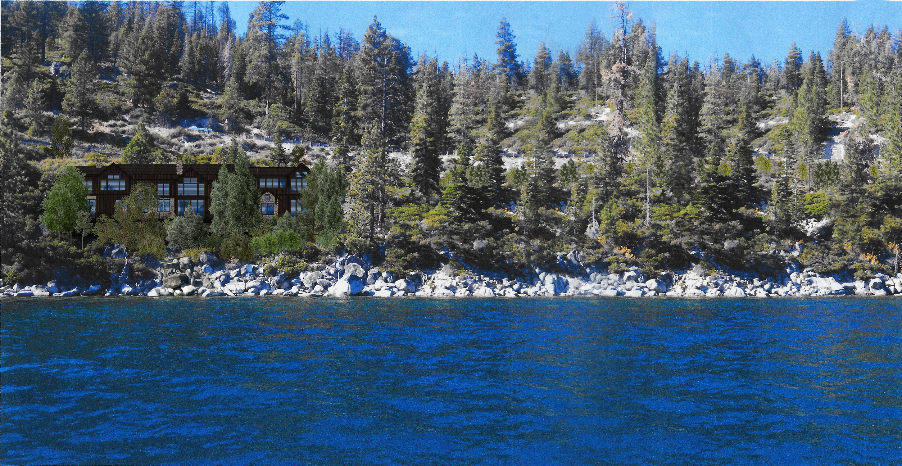
WSUP20-0022 449 Lakeshore Grading
Washoe County Board of Adjustment
February 4, 2021

Slide 2
Request
Request for a driveway to traverse a slope of thirty (30) percent or greater.
Construct a permanent earthen structure greater than 4.5 feet in height within the required front yard setback.
Excavate 1,398 cubic yards on slopes greater than 15%
Grade 28,380 sf (0.65 acres) on a parcel less than six acres in size.
Requesting to vary WCC Section 110.438.45 (d) to allow retaining walls taller than and one-half (4.5) feet within the front yard setback.

Slide 3
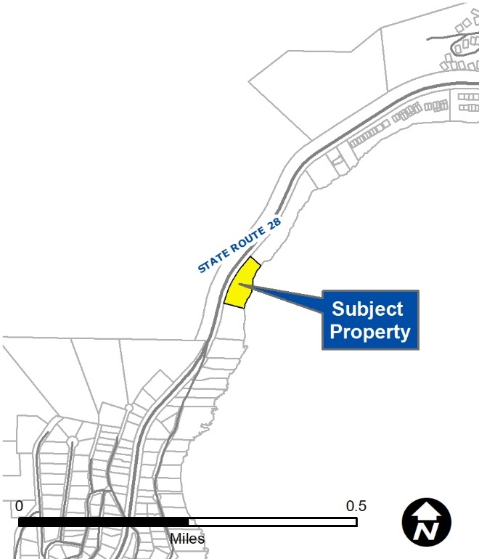
Vicinity Map
Located off of State Route 28
NDOT requires the use of only legal permitted accesses on its State roadways. All driveway accesses and other improvements to the state highway system will be required to comply with the NDOT Access Management System and Standards, and Terms and Conditions Relating to Occupancy Permits current at the time of application.
NDOT standards generally allow direct access to state routes when there are no other means of alternate access available.

Slide 4
Major Grading Thresholds
WCC 110.438.35 (3) Any driveway or road that traverses any slope of thirty (30) percent or greater (steeper).
WCC 110.438.35 (4) Grading to construct a permanent earthen structure greater than four and one-half (4.5) feet within the required front yard setback.

Slide 5
Major Grading Thresholds
WCC 110.438.35(2 )(i)(A) - Grading of one-half (0.5) acre (21,780 square feet) or more on parcels less than six (6) acres in size;
WCC 110.438.35(2)(ii)(A) - Excavation of one thousand (1,000) cubic yards or more whether the material is intended to be permanently located on the project site or temporarily stored on a site for relocation to another, final site, or;

Slide 6
Grading
The proposed grading area is 28,380 square feet,
Cut - 1,398 cubic yards
Fill - 766 cubic yards

Slide 7
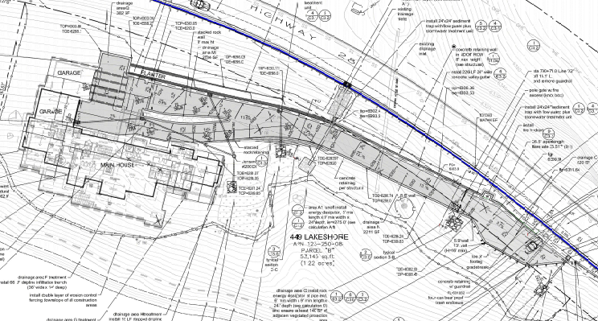
Driveway

Slide 8
Background
The site is undeveloped with trees and native vegetation
The site is constrained with steep slopes.
With the approval of the Special Use Permit, the site will eventually be developed with a garage and large single-family residence.

Slide 9
Request to Vary Standards
WCC Section 110.438.45 (d), Within the front yard setback area of a parcel with a residential use or zoned for residential use, retaining walls are limited to a maximum of four and one-half (4.5) feet.

Slide 10
Request to Vary Standards
Due to the topography of the site, staff is in support of the two requested modifications.
Without these modifications the site would be undevelopable.

Slide 11
Public Notice & CAB
Public notice was sent to 37 parcels
The Incline Village CAB reviewed the application on January 4, 2021 and recommended to approve the project 3-2
Discussion included traffic impact from construction, visual impacts, site suitability, NDOT and TRPA approvals, and the liability related to the construction of the driveway if it were to cause damage to State Route 28

Slide 12
Special Us Permit Findings
1. Consistency;
2. Improvements;
3. Site Suitability; and
4. Issuance Not Detrimental
Staff is able to make all the required findings, as detailed in the staff report

Slide 13
Possible Motion
I move that, after giving reasoned consideration to the information contained in the staff report and information received during the public hearing, the Washoe County Board of Adjustment approve with conditions Special Use Permit Case Number WSUP20-0022 for the Myers Family Trust, having made all five findings in accordance with Washoe County Code Section 110.810.30:

